Slide 1
Getting Started with Supervised Learning, Learning by Computing Distances (1)
CSN-382

Slide 2
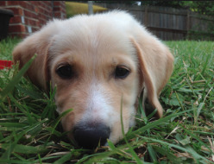
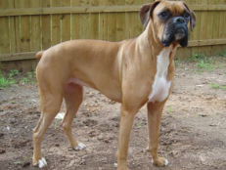
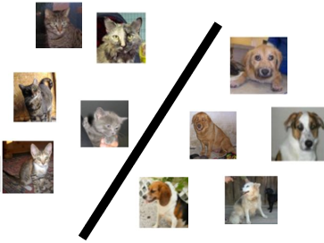







Supervised Learning
Labeled
Training
Data
“dog”
Supervised Learning
Algorithm
“dog”
“cat”
“cat”
Cat vs Dog
Prediction model
“cat”
Important: In ML (not just sup. learning but also unsup. and RL), training and test datasets should be “similar” (we don’t like “out-of-syllabus” questions in exams ☺)
Predicted Label
(cat/dog)
A test image
In the above example, it means that we can’t have test data with BnW images or sketches of cats and dogs
Cat vs Dog
Prediction model
Does it mean ML is useless if this assumption is violated?
Of course not. ☺ Many ML techniques exist to handle such situations (a bit advanced but will touch upon those later)
More formally, the train and test data distributions should be the same
Will give you Just the names for now – domain adaptation, covariate shift, transfer learning, etc
Notes:
Domain adaptation methods include Domain Adaptation, adversarial training, and matching methods.
Other ways are covariate shift, transfer learning etc.

Slide 3
Some Types of Supervised Learning Problems
Consider building an ML module for an e-mail client
Some tasks that we may want this module to perform
Predicting whether an email of spam or normal: Binary Classification
Predicting which of the many folders the email should be sent to: Multi-class Classification
Predicting all the relevant tags for an email: Tagging or Multi-label Classification
Predicting what’s the spam-score of an email: Regression
Predicting which email(s) should be shown at the top: Ranking
Predicting which emails are work/study-related emails: One-class Classification
These predictive modeling tasks can be formulated as supervised learning problems
Today: A very simple supervised learning model for binary/multi-class classification
This model doesn’t require any fancy maths – just computing means and distances

Slide 4
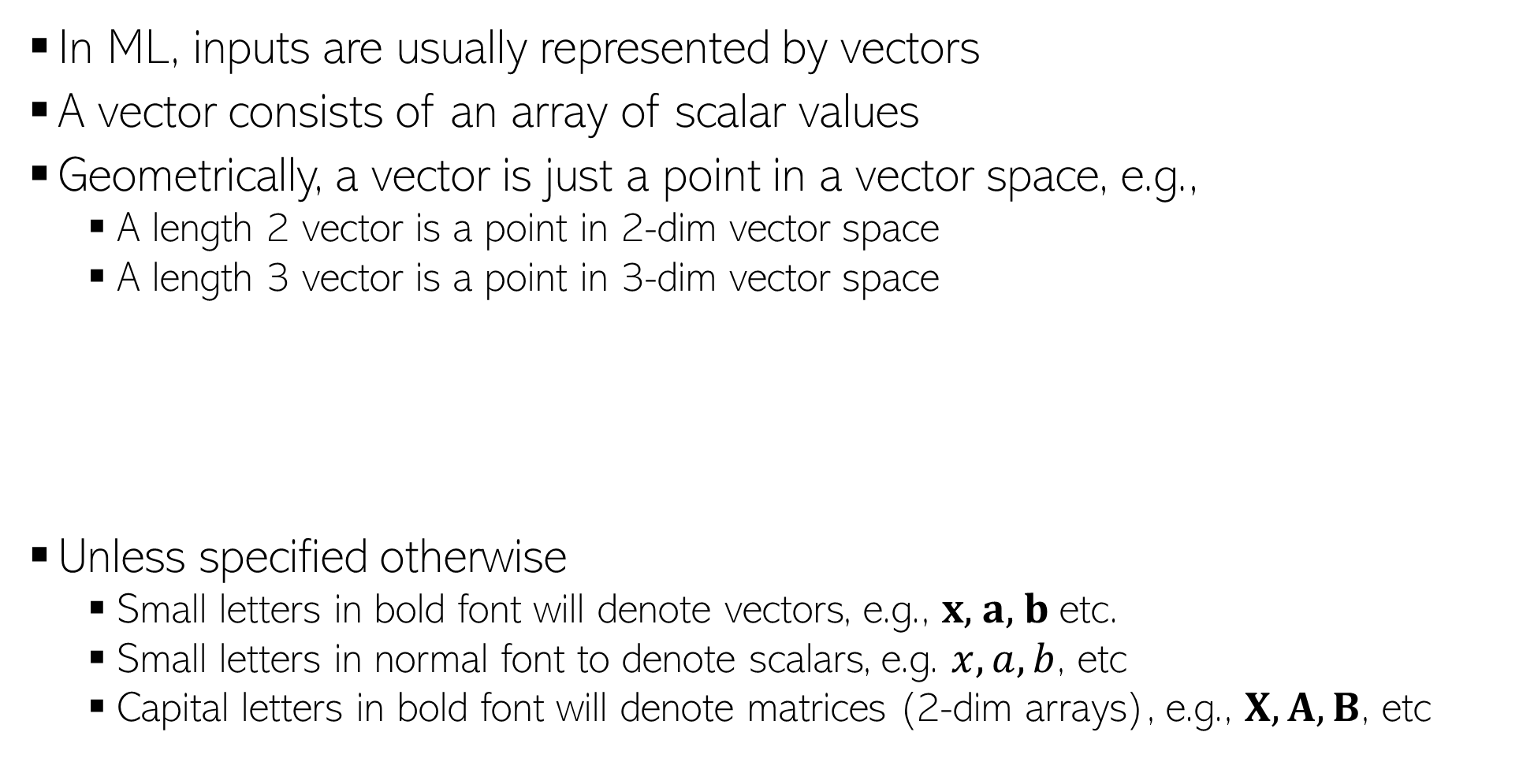
Some Notation and Conventions
In ML, inputs are usually represented by vectors
A vector consists of an array of scalar values
Geometrically, a vector is just a point in a vector space, e.g.,
A length 2 vector is a point in 2-dim vector space
A length 3 vector is a point in 3-dim vector space
Unless specified otherwise
Small letters in bold font will denote vectors, e.g., $x$, $a$, $b$ etc.
Small letters in normal font to denote scalars, e.g. $x, a, b$, etc
Capital letters in bold font will denote matrices (2-dim arrays), e.g., $X, A, B$, etc
0.5 | 0.3 | 0.6 | 0.1 | 0.2 | 0.5 | 0.9 | 0.2 | 0.1 | 0.5
Likewise for higher dimensions, even though harder to visualize
(0.5,0.3)
(0.5,0.3,0.6)
0.5 | 0.3 | 0.6
0.5 | 0.3

Slide 5
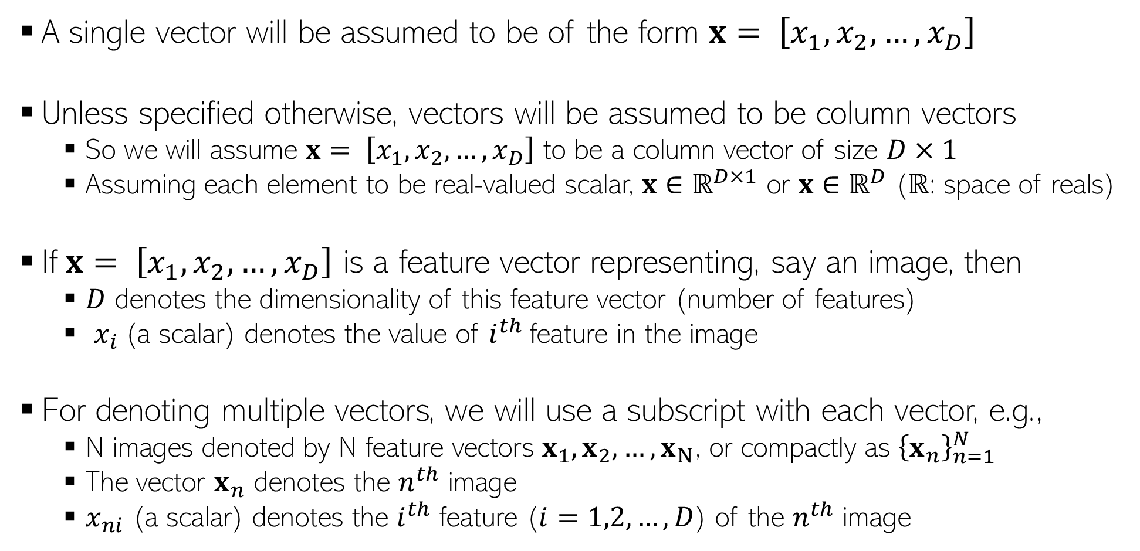
Some Notation and Conventions
A single vector will be assumed to be of the form $x= \left[x_{1},x_{2},…,x_{D}\right]$
Unless specified otherwise, vectors will be assumed to be column vectors
So we will assume $x= \left[x_{1},x_{2},…,x_{D}\right]$ to be a column vector of size $D×1$
Assuming each element to be real-valued scalar, $x$ $∈ℝ^{D×1}$ or $x$ $∈ℝ^{D}$ ($ℝ$: space of reals)
If$x= \left[x_{1},x_{2},…,x_{D}\right]$ is a feature vector representing, say an image, then
$D$ denotes the dimensionality of this feature vector (number of features)
$x_{i}$(a scalar) denotes the value of $i^{th}$feature in the image
For denoting multiple vectors, we will use a subscript with each vector, e.g.,
N images denoted by N feature vectors $x_{1}, x_{2},…,x_{N}$, or compactly as ${\left\{x_{n}\right\}}_{n=1}^{N}$
The vector $x_{n}$ denotes the $n^{th}$ image
$x_{ni}$ (a scalar) denotes the $i^{th}$ feature ($i=1,2,…,D$) of the $n^{th}$ image

Slide 6
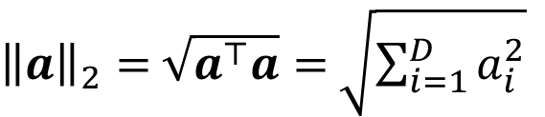
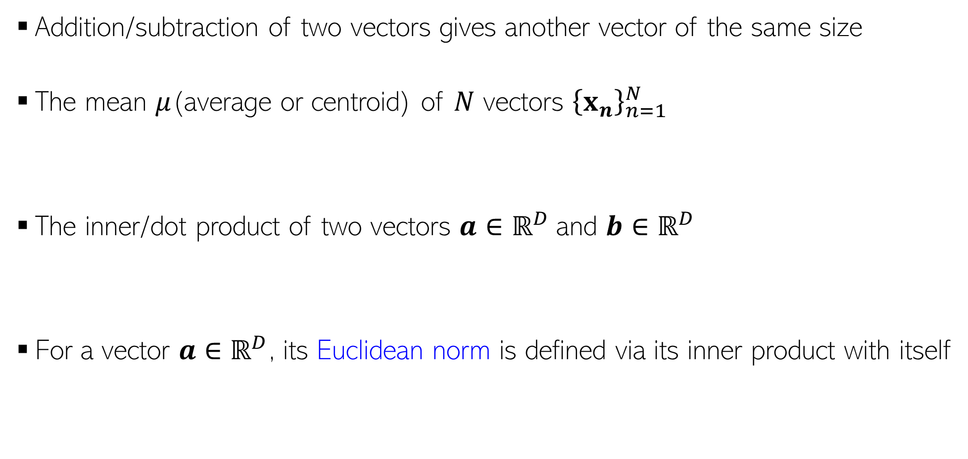
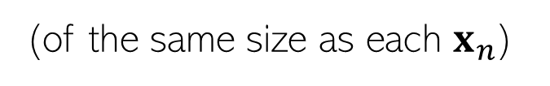

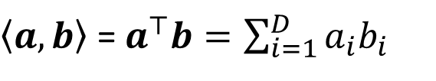

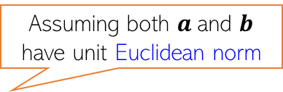
Some Basic Operations on Vectors
Addition/subtraction of two vectors gives another vector of the same size
The mean $μ$(average or centroid) of $N$ vectors ${\left\{x_{n}\right\}}_{n=1}^{N}$
The inner/dot product of two vectors $a$ $∈ℝ^{D}$and $b$ $∈ℝ^{D}$
For a vector $a$ $∈ℝ^{D}$, its Euclidean norm is defined via its inner product with itself
$$μ= \frac{1}{N}\sum_{n=1}^{N}{x_{n}}$$
(of the same size as each $x_{n}$)
Assuming both $a$and $b$ have unit Euclidean norm
$\left\langle a,b\right\rangle$ = $a^{⊤}b=\sum_{i=1}^{D}{a_{i}b_{i}}$
(a real-valued number denoting how “similar” $a$and $b$are)
${\left\|a\right\|}_{2}=$ $\sqrt{a^{⊤}a}=$ $\sqrt{\sum_{i=1}^{D}{a_{i}^{2}}}$
Also the Euclidean distance of $a$ from origin
Note: Euclidean norm is also called L2 norm

Slide 7

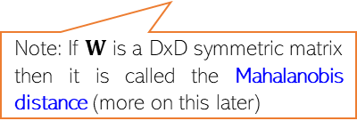

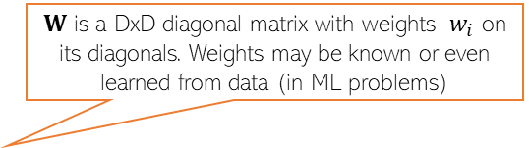
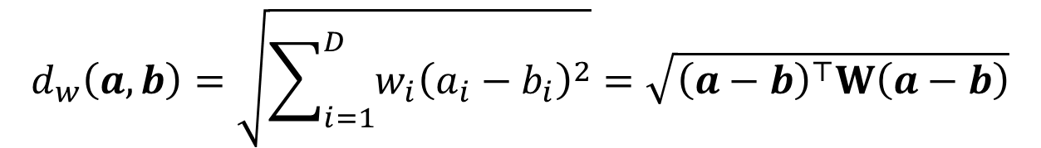
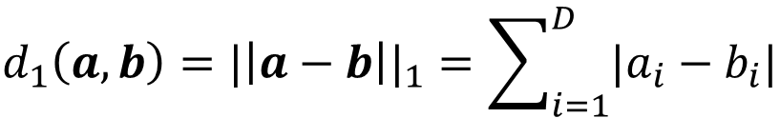
Computing Distances
Euclidean (L2 norm) distance between two vectors $a$ $∈ℝ^{D}$and $b$ $∈ℝ^{D}$
Weighted Euclidean distance between two vectors $a$ $∈ℝ^{D}$and $b$ $∈ℝ^{D}$
Absolute (L1 norm) distance between two vectors $a$ $∈ℝ^{D}$and $b$ $∈ℝ^{D}$
Sqrt of Inner product of the difference vector!
Another expression in terms of inner products of individual vectors
$$d_{2}\left(a,b\right)={|\left|a−b\right||}_{2}=\sqrt{\sum_{i=1}^{D}{{\left(a_{i}−b_{i}\right)}^{2}}}=\sqrt{{\left(a−b\right)}^{⊤}\left(a−b\right)}=\sqrt{a^{⊤}a+b^{⊤}b−2a^{⊤}b}$$
Useful tip: Can achieve the effect of feature scaling (recall last lecture) by using weighted Euclidean distances!
$W$ is a DxD diagonal matrix with weights $w_{i}$ on its diagonals. Weights may be known or even learned from data (in ML problems)
$$d_{w}\left(a,b\right)=\sqrt{\sum_{i=1}^{D}{{w_{i}\left(a_{i}−b_{i}\right)}^{2}}}=\sqrt{{\left(a−b\right)}^{⊤}W\left(a−b\right)}$$
Note: If $W$ is a DxD symmetric matrix then it is called the Mahalanobis distance (more on this later)
L1 norm distance is also known as the Manhattan distance or Taxicab norm
(it’s a very natural notion of distance between two points in some vector space)
Apart from L2 and L1. there other ways of defining distances?
$$d_{1}\left(a,b\right)={|\left|a−b\right||}_{1}=\sum_{i=1}^{D}{|a_{i}−b_{i}|}$$
Yes. Another, although less commonly used, distance is the L-infinity distance (equals to max of abs-value of element-wise difference between two vectors

Slide 8
Our First Supervised Learner

Slide 9


Prelude: A Very Primitive Classifier
The idea also applies to multi-class classification: Use one image per class, and predict label based on the distances of the test image from all such images
Consider a binary classification problem – cat vs dog
Assume training data with just 2 images – one and one
Given a new test image (cat/dog), how do we predict its label?
A simple idea: Predict using its distance from each of the 2 training images
d( , ) < d( , ) ? Predict cat else dog
Test
image
Test
image
Wait. Is it ML? Seems to be like just a simple “rule”. Where is the “learning” part in this?
Some possibilities: Use a feature learning/selection algorithm to extract features, and use a Mahalanobis distance where you learn the W matrix (instead of using a predefined W), using “distance metric learning” techniques
Excellent question! Glad you asked!
Even this simple model can be learned. For example, for the feature extraction/selection part and/or for the distance computation part
Notes:
Learning => distance metrics learning, probability distribution learning instead of single image per class, feature learning,

Slide 10
Improving Our Primitive Classifier
Just one input per class may not sufficiently capture variations in a class
A natural improvement can be by using more inputs per class
We will consider two approaches to do this
Learning with Prototypes (LwP)
Nearest Neighbors (NN – not “neural networks”, at least not for now ☺)
Both LwP and NN will use multiple inputs per class but in different ways
“cat”
“dog”
“cat”
“dog”
“cat”
“dog”

Slide 11
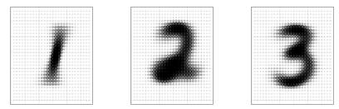
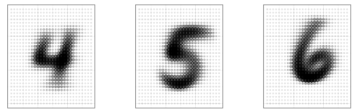

Learning with Prototypes (LwP)
Basic idea: Represent each class by a “prototype” vector
Class Prototype: The “mean” or “average” of inputs from that class
Predict label of each test input based on its distances from the class prototypes
Predicted label will be the class that is the closest to the test input
How we compute distances can have an effect on the accuracy of this model (may need to try Euclidean, weight Euclidean, Mahalanobis, or something else)
Averages (prototypes) of each of the handwritten digits 1-9
Pic from: https://www.reddit.com/r/dataisbeautiful/comments/3wgbv9/average_handwritten_digit_oc/

Slide 12





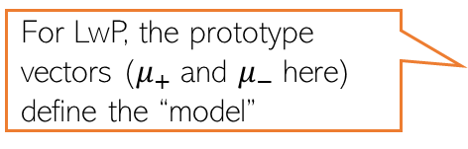
Learning with Prototypes (LwP): An Illustration
Suppose the task is binary classification (two classes assumed pos and neg)
Training data: $N$ labelled examples ${\{\left(x_{n},y_{n}\right)\}}_{n=1}^{N}$,${ x}_{n}∈ℝ^{D}$, ${ y}_{n} ∈\{−1,+1\}$
Assume $N_{+}$ example from positive class, $N_{−}$ examples from negative class
Assume green is positive and red is negative
$$μ_{−}= \frac{1}{N_{−}}\sum_{y_{n}=−1}{x_{n}}$$
$$μ_{+}= \frac{1}{N_{+}}\sum_{y_{n}=+1}{x_{n}}$$
$$μ_{−}$$
$$μ_{+}$$
LwP straightforwardly generalizes to more than 2 classes as well (multi-class classification) – K prototypes for K classes
For LwP, the prototype vectors ($μ_{+}$and $μ_{−}$here) define the “model”
Test example
Test example

Slide 13



LwP: The Prediction Rule, Mathematically
What does the prediction rule for LwP look like mathematically?
Assume we are using Euclidean distances here
$${\left|\left|μ_{−}−x\right|\right|}^{2}={\left|\left|μ_{−}\right|\right|}^{2}+{\left|\left|x\right|\right|}^{2}−2\left\langle μ_{−},x\right\rangle$$
$$μ_{−}$$
$$μ_{+}$$
$${\left|\left|μ_{+}−x\right|\right|}^{2}={\left|\left|μ_{+}\right|\right|}^{2}+{\left|\left|x\right|\right|}^{2}−2\left\langle μ_{+},x\right\rangle$$
Test example $x$
Prediction Rule: Predict label as +1 if $f\left(x\right)={\left|\left|μ_{−}−x\right|\right|}^{2}$ $−$ ${\left|\left|μ_{+}−x\right|\right|}^{2}>0$ otherwise -1

Slide 14
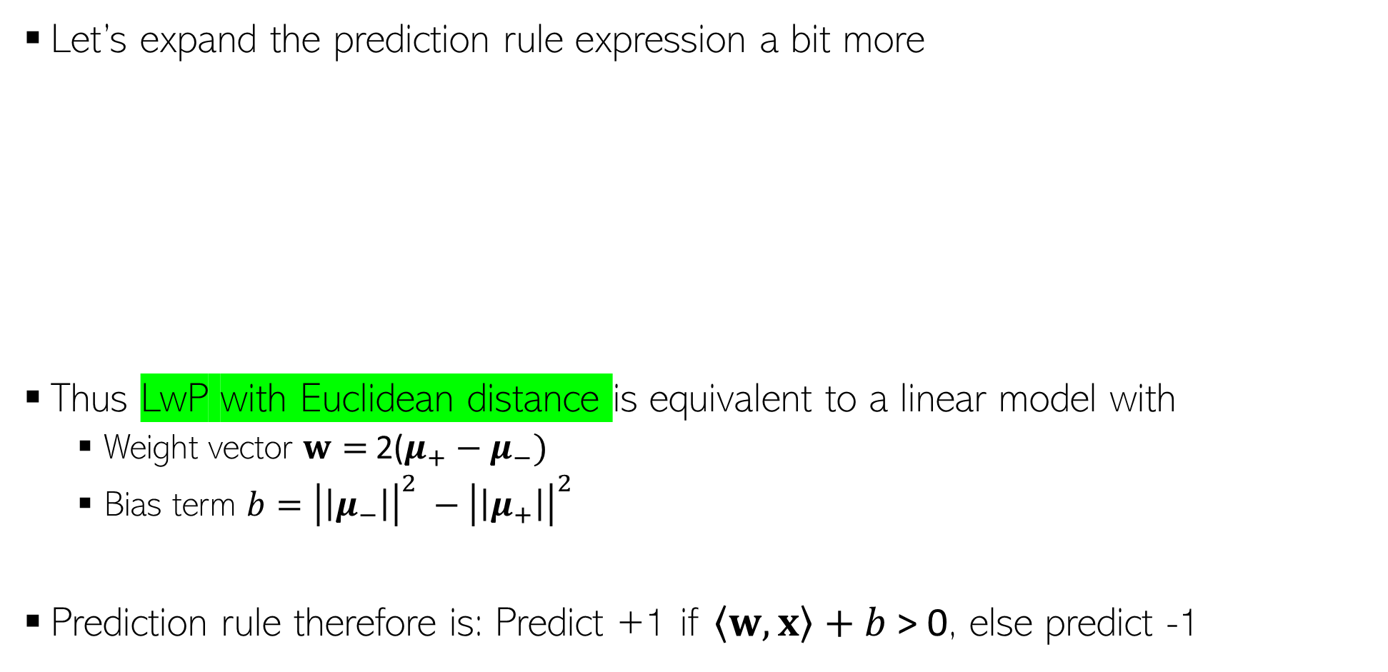
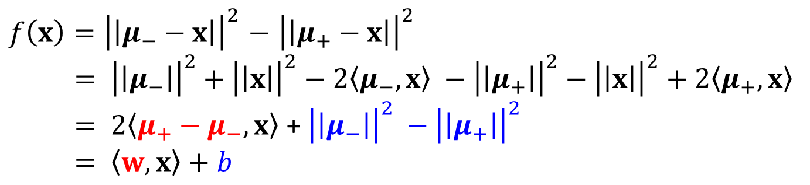
LwP: The Prediction Rule, Mathematically
Let’s expand the prediction rule expression a bit more
Thus LwP with Euclidean distance is equivalent to a linear model with
Weight vector $w=$2($μ_{+}−μ_{−})$
Bias term $b={\left|\left|μ_{−}\right|\right|}^{2} −{\left|\left|μ_{+}\right|\right|}^{2}$
Prediction rule therefore is: Predict +1 if $\left\langle w,x\right\rangle +b$ > 0, else predict -1
$f\left(x\right)={\left|\left|μ_{−}−x\right|\right|}^{2}$ $−$ ${\left|\left|μ_{+}−x\right|\right|}^{2}$
$= {\left|\left|μ_{−}\right|\right|}^{2}+{\left|\left|x\right|\right|}^{2}−2\left\langle μ_{−},x\right\rangle −{\left|\left|μ_{+}\right|\right|}^{2}−{\left|\left|x\right|\right|}^{2}+2\left\langle μ_{+},x\right\rangle$
$= 2\left\langle μ_{+}−μ_{−},x\right\rangle$ + ${\left|\left|μ_{−}\right|\right|}^{2} −{\left|\left|μ_{+}\right|\right|}^{2}$
$= \left\langle w,x\right\rangle +b$
Will look at linear models more formally and in more detail later

Slide 15



LwP: Some Failure Cases
Here is a case where LwP with Euclidean distance may not work well
In general, if classes are not equisized and spherical, LwP with Euclidean distance will usually not work well (but improvements possible; will discuss later)
Can use feature scaling or use Mahalanobis distance to handle such cases (will discuss this in the next lecture)
$$μ_{−}$$
$$μ_{+}$$
Test example $x$
Notes:
Distribution of classes is not same and hence distance which takes class distribution into account must be used here.
Apart from mahanalobis, weighted Euclidean can also be used here.

Slide 16
LwP: Some Key Aspects
Very simple, interpretable, and lightweight model
Just requires computing and storing the class prototype vectors
Works with any number of classes (thus for multi-class classification as well)
Can be generalized in various ways to improve it further, e.g.,
Modeling each class by a probability distribution rather than just a prototype vector
Using distances other than the standard Euclidean distance (e.g., Mahalanobis)
With a learned distance function, can work very well even with very few examples from each class (used in some “few-shot learning” models nowadays – if interested, please refer to “Prototypical Networks for Few-shot Learning”)
How well LwP works depends crucially on the way we compute distances

